Slide 1
Battle of the Neighborhoods
Manhattan vs. Queens

Slide 2
Introduction
The Problem:
Is it better to move to Queens or to a new neighborhood in Manhattan?
Target Audience:
The Roomate
Criteria to Consider
1. Does the neighborhood in question possess each of the following:
Bagel Shop
Ramen Restaurant
Italian Restaurant
Art Museums
Wine Shop
2. Is the neighborhood in question similar to Lenox Hill

Slide 3

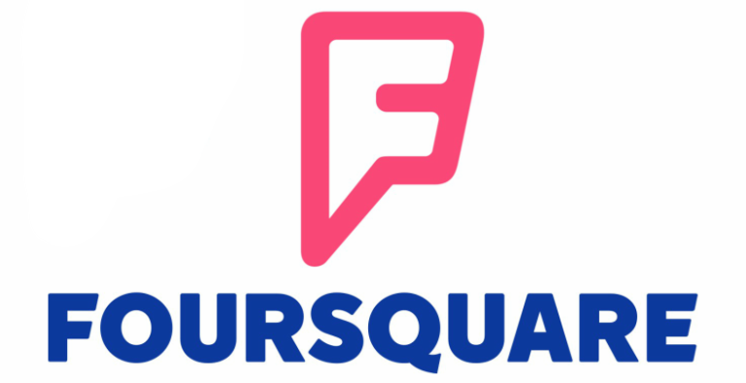
Data
New York University Data Set
Details on the neighborhoods of all five boroughs of NYC
Foursquare Location Data Set
Details on venues in the neighborhoods
Notes:
NYU Logo from https://guides.nyu.edu/copyright/nyupermissions
Foursquare logo from foursquare.com

Slide 4
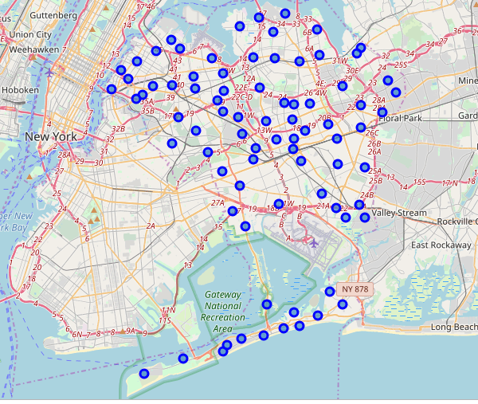
Queens – Individual Analysis
Process:
The Queens data was extracted from the NYU dataset and then Foursquare venue data was added.
Folium was used to plot a map of the neighborhoods
The neighborhoods were then analyzed on an individual basis to determine which, if any, possessed the required types of venue.

Slide 5
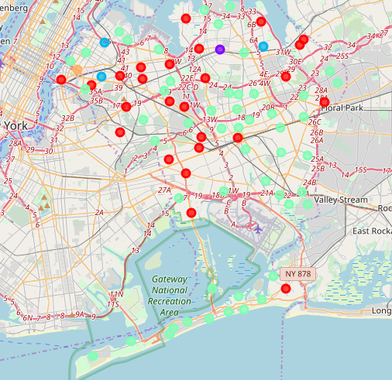
Queens – K-Means clustering
Process
Used K-Means Clustering, an unsupervised Machine Learning Technique, to cluster similar neighborhoods
Folium was used to create a map to visualize the clusters
The results were used to determine which neighborhoods, if any, were similar to Lenox Hill

Slide 6
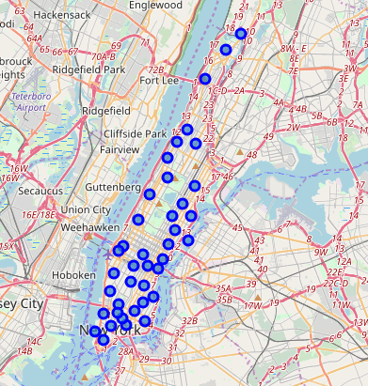
Manhattan – individual analysis
Process:
The Manhattan data was extracted from the NYU dataset and then Foursquare venue data was added.
Folium was used to plot a map of the neighborhoods
The neighborhoods were then analyzed on an individual basis to determine which, if any, possessed the required types of venue

Slide 7
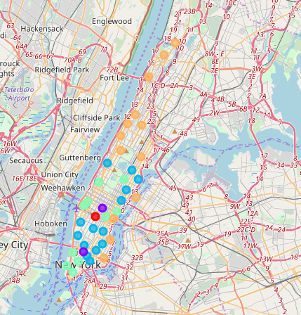
Manhattan – K-means clustering
Process
Used K-Means Clustering, an unsupervised Machine Learning Technique, to cluster similar neighborhoods
Folium was used to create a map to visualize the clusters
The results were used to determine which neighborhoods, if any, were similar to Lenox Hill

Slide 8
Results
Queens
Individual Analysis:
No neighborhoods had all 5 venues
Two had 3 of the 5:
Ravenswood
Hunters Point
Clustering:
- No neighborhoods in Queens were similar to Lenox Hill
Manhattan
Individual Analysis:
One neighborhood had all 5 venues:
Carnegie Hill
Two neighborhoods had 4 of 5:
Gramercy
Greenwich Village
Clustering:
- All three of these venues were similar to Lenox Hill

Slide 9

Recommendation
Remain in Manhattan and consider Carnegie Hill

